Slide 1
Admin Announcements
61st JDPC
23 – 24 May 2018
LCDR Omari Buckley

Slide 2
Administrative Remarks
61st JDPC
In-Processing/badges
Classification level (Unclassified)
No cell phones, pagers, laptops,
Attendance rosters
Verify information
Late updates to briefings
See LCDR Buckley/ Michelle Jackson
Agenda Changes
Photo on Day 1 (Lobby)*
Executive Session
Feedback Forms
Procedures for JDPC Minutes
Final Minutes will be posted on JDEIS once approved by JS J-7
Leave badges at front desk upon departure

Slide 3
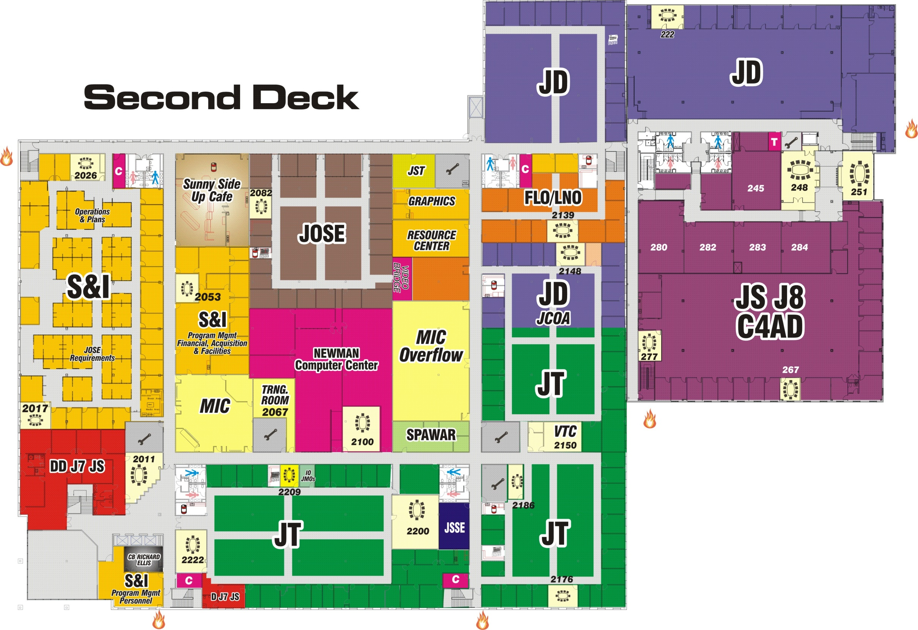
JS Second Deck
61st JDPC
Cafe
Emer Exit
Restrooms

