Slide 1
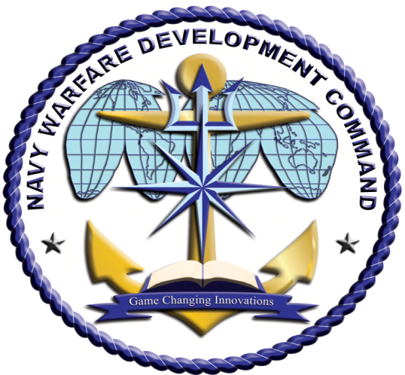
Navy Warfare Development Command
RDML Marcus A. Hitchcock

Slide 2
NWDC Operational Design
Concepts
OPNAV/USFFC
Ways
(LOOs)
USFFC/CPF
NFC
OLW and Advanced Cross Domain Warfighting Development
Fleet
Warfighters
WDCs
Cross Domain Integration
OLW Warfighting Development & Integration
Means (LOEs)
Wargaming, Modeling & Simulation
Fleet Experimentation
Doctrine,
Lessons & Analysis
Navy-Wide Mission Support
NWDC develops and integrates innovative solutions to complex naval warfare challenges to enhance current and future warfighting capabilities

Slide 3
What We Do
Concepts
Identifies future capabilities
based on challenges and
opportunities
Doctrine
Provides fundamental
principles guiding military
forces
CONOPS
Bridges Concepts to
future Doctrine/TTP
Military Problem
War Games
Explores decision making
possibilities and captures
human insights
Fleet Lessons
Accelerates learning through
rigorous self-assessment
Experimentation
Explores the effects of
proposed warfighting
capabilities
Modeling & Simulation
Logical representation of
systems, environments, and
models over time to develop
COAs

Slide 4
Cross Domain Integration

Slide 5
