Slide 1
Development, Concepts and Doctrine Centre UK Doctrine 2018
Head Doctrine, Air, Space and Cyber
Notes:
Welcome to DCDC. DCDC (Development, Concepts and Doctrine Centre) is the MOD’s think-tank, located within the Defence Academy as part of the Joint Force Development construct. Created in 1999 following the 1998 Strategic Defence Review which recognised the need for a clearer long-term joint, vision of the way we expect our forces to operate.
The brain: DCDC is all about the conceptual component of fighting power. In a Complex and uncertain strategic context the requirement to use the conceptual component – to think – becomes increasingly important. Proliferation and speed of information flows, characterised by a state of constant competition that blurs traditional distinctions between war and peace; foreign and homeland threats have also merged. Potential adversaries blend conventional and unconventional forms of conflict, using both attributable and non-attributable methods.
Overcoming our adversaries – who think, react and adapt, requires Defence to optimise its professional ability to anticipate, learn and adapt. As well as being adaptable, the UK’s armed forces will also need to be agile, both physically and mentally.
The conceptual component provides commanders with the ability to understand the context within which they operate and serves as the foundation upon which creativity, ingenuity and initiative may be exercised in complex situations. The conceptual component comprises three elements: the principles of war; doctrine; and conceptual innovation.
In the past we have been accused of getting this wrong:
- Field Marshall Erwin Rommel ‘The British write the best manuals in the world….thank God they don’t read them.’
- Chilcott Report: evidence based decision-making rather than decision-based evidence making…
- Of course, mental agility becomes increasingly important in an age of austerity: Winston Churchill ‘Gentlemen, We Have Run Out Of Money; Now We Have to Think.’
- ‘The nation that insists upon drawing a broad line of demarcation between the fighting man and the thinking man is liable to find its fighting done by fools and its thinking by cowards.’ Lt Gen Sir William Butler
- ‘No problem can withstand the assault of sustained thinking.’ Voltaire

Slide 2
DCDC - Guiding Principle (Nov 16)
Vision
“
“
To be a leader in innovative and respected Defence thinking.
Develop | look forward, to grow Defence’s conceptual understanding and thinking
Deepen | to strengthen and increase Defence’s conceptual understanding of current thinking
Challenge | to test the validity of Defence’s conceptual thinking to avoid group think
Inform | to provide facts and information for others to decide.
Guide | to show or indicate the way
Guiding Principle
To develop, deepen and challenge the conceptual component of Defence’s contribution to national power in order to produce outputs that inform Defence policy, strategy and force development, and guide operational activity and joint training and education.
Notes:
Welcome to the course
DCDC seeks to inform defence strategy by developing concepts and innovative thinking.
Challenge and question
Maintain doctrine underpinned by evidence

Slide 3
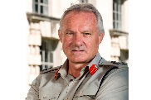
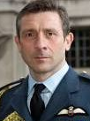
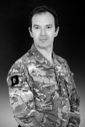
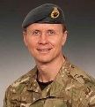
Governance
Vice Chief of the Defence Staff
Sec Pol
Comd Joint Forces Command
Joint Doctrine and Concepts Board
Mil Cap
DG Joint Force Development
MSO
Strat & Int
Development Concepts and Doctrine Centre
Director Joint Warfare
JSCSC
SJFHQ
RAF FD (ACAS)
Army FD (DSTRAT)
RN FD (ACNS Pol)
JWDB
JFC FD (COS JFC)
Notes:
Unique Governance and structure
Located on the Defence Academy Site
Support and resources from JFD
Direction from VCDS and the JDCB – linkages to MOD Strategy and plans for UK and NATO
Provides excellent linkage between Education JSCSC and Doctrine development – Doctrine regeneration programme
Provides linkages with the Joint Force – SJFHQ development

Slide 4
Doctrine Pillar

Slide 5
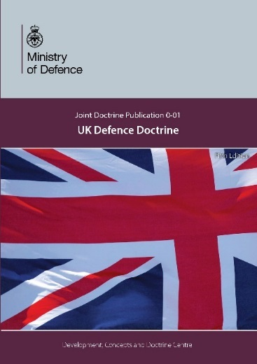
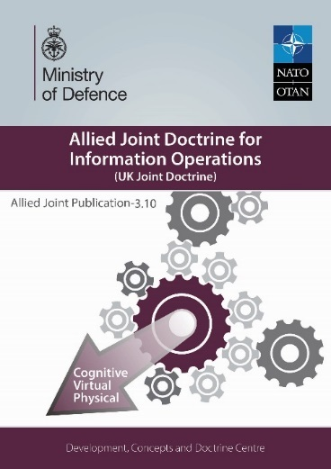
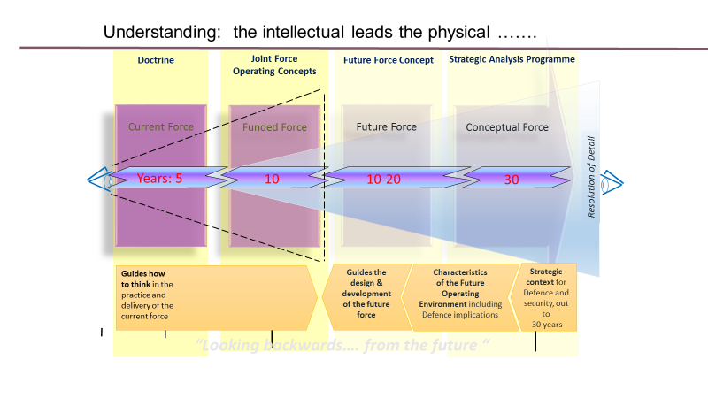
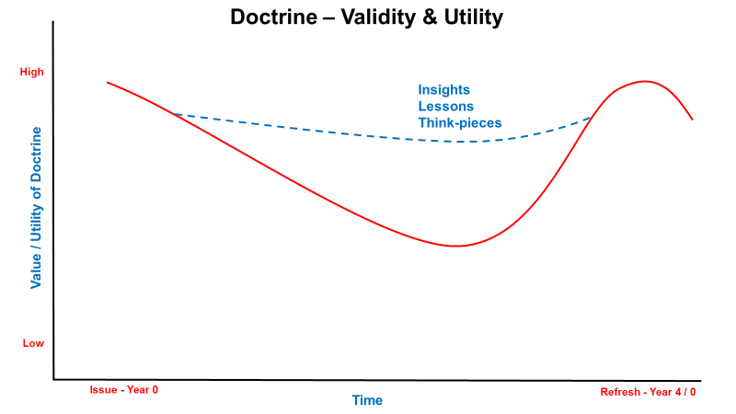
Doctrine Plan
Modern Deterrence (JDP)
UK Defence - capstone doctrine (JDP refresh)
Full Spectrum Approach JDN
Cyber doctrine review (JDP)
Space primer
Defence Engagement JDP
Info Ops/ StratCom (UK/NATO doctrine)
Doctrine Education and awareness
Contribution to NATO publications
Doctrine routine refresh
Sp to Def Ac Education Regeneration Programme
Doctrine Writing Course - pilot Mar/Apr 18
Enhance lessons and experimentation
Doctrine consultancy
UK Doctrine Development – UK DD, Deterrence, Cyber, SF, DE
NATO Doctrine Development – StratCom, Opsec and Deception, AJP-1
Lessons and Education
Notes:
The doctrine pillar has 92 documents on our books…of which 43 are UK; JDP, JDN and Primers, of the 49 NATO documents we hold the pen (custodianship) on 6 AJPs. (including Allied Joint Doctrine, Intelligence procedures, IO, PsyOps and Land Operations.)
Must, should and could…priorities for this year are those in the green box…ME are Modern Deterrence, UK Defence Doctrine…..
UK Defence Doctrine will address ‘Full Spectrum Approach’ or Fusion Doctrine, CEMA – to reflect our new doctrine, modern deterrence, the implications arising from the Chilcott Inquiry into the conflict in Iraq, the role of Information and the UK Defence Lines of Development – TEPIDOIL. We aim to have the doctrine published by Feb 19.
Modern Deterrence…the emphasis of this doctrine is to broaden our thinking, activities and education beyond the realm of nuclear weapons – it focuses on the 21st Century context: changing polarities and threats, the role of intelligence and information and the challenges presented by ‘grey’ conflicts. The document explores the military contribution to deterrence and how this nests a fused, pan-Government approach.
On the NATO front our focus this year is on IO, PsyOps, cyber and STRATCOM…. We are part of the writing team for cyber AJP 3.20. We are assisting the STARTCOM COE by running the data fusion workshop for this new doctrine. All these publications are central to developing NATO and the UK’s understanding of information.
More widely, we have just conducted our first Doctrine Writing Course and are updating our Doctrine Writing guide…the former, based on the later, has received very positive feedback and we are now exploring options of taking this course forward nationally, with NATO and with the wider international defence community.

Slide 6
Final thoughts
“Minds are like parachutes - they only function when open.”
Thomas Dewar

