Slide 1
Converting Naval Littoral Operations in a Contested Environment and Other Concepts to Doctrine NWDC Mr. Bob Oldani Doctrine Director (N5D) 757.341.4183 robert.oldani@navy(.smil).mil 24 May 2018

Slide 2
Converting Concepts to Doctrine
Purpose:
Inform Joint Doctrine Development Community of Navy efforts to convert Concepts to Doctrine
Inform JDDC of Navy Doctrine and TTP development efforts
Inform JDDC of potential doctrine impacts of Navy LOCE Concept
Background:
Navy Concept to Doctrine cycle has matured over time
Littoral Operations in a Contested Environment (LOCE) is a recent example. LOCE was signed 27 Feb 2017 by CNO & CMC
NWDC and CD&I assigned as co leads on Task 17: Develop a POA&M for incorporation of validated TTP into appropriate doctrine per paragraph 8.c. of LOCE CONOPS
Recommendation:
Provided for information only
Assessment:
Converting concepts to doctrine through a determined process of experimentation, exercises and wargames is a proven process
Continue collaborating with joint partners

Slide 3
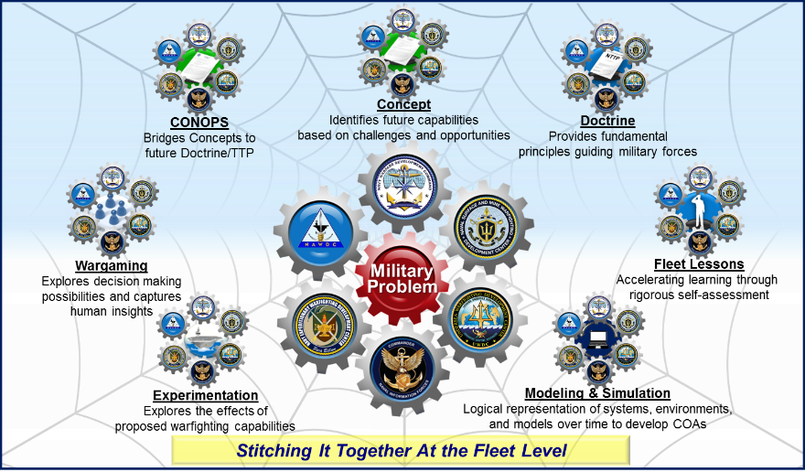
NWDC - WDC Integration

Slide 4
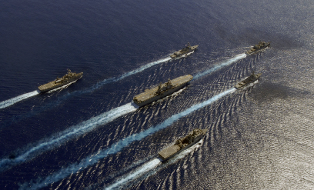
Littoral Operations in a Contested Environment (LOCE)
UNCLASSIFIED
Overview:
CNO and CMC tasked NWDC and MCWL to write LOCE concept in Aug 2015
A seminar wargame and Naval Services Game 2016 informed concept writing
Writing team presented quarterly updates to the Naval Board
Concept signed by CNO and CMC 27 February 2017
Problem Statement:
Navy and Marine Corps retain the initiative, operating as an integrated naval force from dispersed locations ashore and afloat to achieve local sea control and project power into contested littoral areas against advanced threats.
Key Ideas:
Littoral Combat Group (LCG) formation
ARG/MEU +1 or more combatants and/or NECC
Can work alone or with a carrier strike group
Navy-Marine CWC C2 Construct
Integrated blue-green staff for all operations
Avoids seam during CATF/CLF transition
May add new “Expeditionary Warfare Commander”
Marine could serve as Strike Warfare Commander
Marines contribute to sea control fight
Integrated blue-green Fleet/JFMCC staff
UNCLASSIFIED

Slide 5
LOCE Task 17
Focus areas:
Identify affected publications:
33 potential publications (JPs, USN, USMC, ALSA) identified; or more…
Identify list of events, experiments, wargames and others that provide opportunities to influence, test, and exercise LOCE TTP development
Way Ahead:
Incorporate feedback from MWG
Send draft POA&M to USFF, MARFORCOM, PACFLT, MARFORPAC, EXWDC, IWDC, SMWDC, NAWDC, UWDC for review and feedback
Conduct final review to NWDC & CD&I leadership
Submit POA&M to USFF in Apr 18
Execute elements of POA&M over ~6 year
Update POA&M as circumstances warrant

Slide 6
Representative POA&M Actions
Generate list of publications that may provide opportunities to influence LOCE TTP development.
Identify list of events, experiments, wargames and others that provide opportunities to influence, test, and exercise LOCE TTP development.
Ensure appropriate doctrine representation present at wargames, exercises, and events (C2, EABO, DMO, MCM).

Slide 7
Initial Doctrine Areas Affected
Identify affected publications:
33 potential publications (JPs, USN, USMC, ALSA) identified; or more…
3-01 Air Defense (3)
3-02 Amphibious Operations (10)
3-03 Strike Warfare (2)
3-09 Strike and Fire Support (1)
3-10 Expeditionary Warfare (4)
3-15 Mine Warfare (2)
3-20 Surface Warfare (1)
3-21 Anti-Submarine Warfare (1)
3-30 Naval C2 of Air Operations (1)
3-32 C2 for Joint Maritime Operations (3)
3-51 Electronic Warfare (1)
3-56 Operational Command and Control (1)
3-62 Seabasing (1)
4-01 Logistics (2)

Slide 8
Initial List of LOCE Experiments, Wargames, & Events
Identify list of events, experiments, wargames and others that provide opportunities to influence, test, and exercise LOCE TTP development.
MCWL Collections plan, NWDC FLEX
Dawn Blitz, CTF 51 & 5th MEB Naval Integration, Naval Integration in support of DMO, Cobra Gold 18, 15th MEU, MPF Exercise Ssang Yong, F35 MEU ACE, NSG 18, RIMPAC 2018, MLG Prep future operating env, Trident Juncture 18, LSE 2020
Venues/Events
MWG, PNIWG, CPAOT, WDCs, and CD&I coordination
After actions and lessons learned.

Slide 9
EMW Concept to Doctrine
Electromagnetic Maneuver Warfare (EMW) drives fleet awareness toward CNO desired endstate.
Assured Command and Control (C2)
Battlespace Awareness (BA)
Maneuver
Integrated Fires
EMW is necessitated by contested and congested nature of the EM Spectrum
EMW is aligned to related DoD efforts in joint doctrine, concepts and the DoD EMS Strategy roadmap

Slide 10
Questions/Comments?

