Slide 1
“This briefing is for information only. No US Government commitment to sell, loan, lease, co-develop or co-produce defense articles is implied or intended.”
Mark Cyr, GS-15
Chief, USTRANSCOM Policy & Doctrine Division

Slide 2
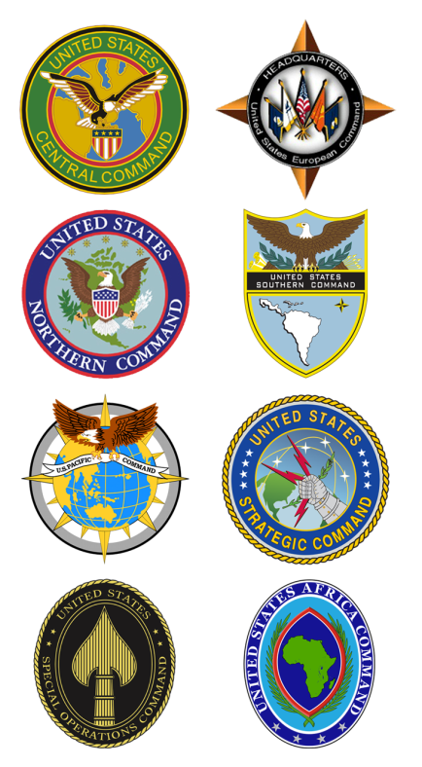
USTRANSCOM WITHIN DOD
TOGETHER, WE DELIVER.
*Established 1987
SDDC
JECC
MSC
JTRU
AMC
USTRANSCOM provides full-spectrum global mobility solutions and related
enabling capabilities for the nation and coalition partners in peace and war.

Slide 3
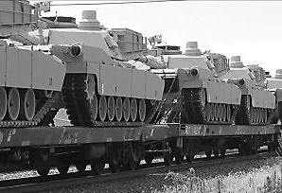
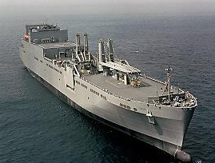
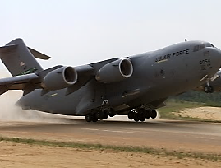
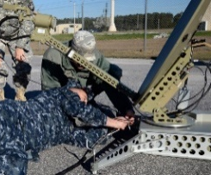
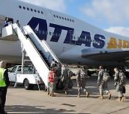
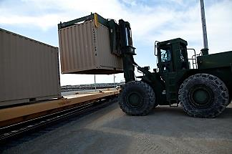
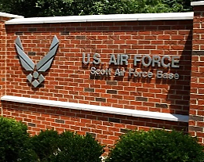
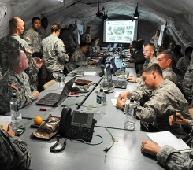
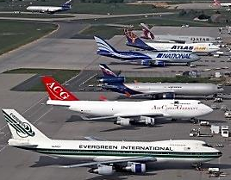
JOINT DEPLOYMENT DISTRIBUTION ENTERPRISE (JDDE)
> 133,000
People
$7.3B
Portfolio
TOGETHER, WE DELIVER.
Military Surface Deployment & Distribution Cmd
Joint Enabling
Capabilities
Command
Commercial Industry Contribution
Military Sealift Command
Air Mobility Command
~454
Aircraft
~397
Vessels
WEAPON
SYSTEMS
INFRASTRUCTURE
NETWORK
SYSTEMS
DoDIN
Unclassified Commercial
USCYBERCOM
Dept of Homeland Secty

Slide 4
THE GLOBAL DISTRIBUTION NETWORK (GDN)
TOGETHER, WE DELIVER.
AIR
SEA
LAND
Mobility
Joint Force
Provider
(2006)
Global
Distribution
Operations
Synchronizer
(2011)
GDN is a multi-dimensional network of…
Distribution
Process
Owner
(2003)
Routes
- Lines of Communication
Modes
- Air, Land, & Sea
Nodes
- En route Infrastructure
Providers
- Commercial Industry / Military Services
Access
- Host Nation Agreements
Information Network
- IT, Communications
Distributed C2
- Globally Positioned
Joint
Enabling
Capabilities
Provider
(2011)
Single
Manager for
Global Patient
Movement
(1993)
New
Joint
Deployment &
Distribution
Coordinator
(2017)
Single
Manager for
Transportation
(1992)
…that provides the National Command Authorities with global REACH in support
of US national security objectives.

Slide 5
UNIFIED COMMAND PLAN – JDDC AUTHORITIES
TOGETHER, WE DELIVER.
CDRUSTRANSCOM exercises coordinating authority for JDDE operations and planning across all domains and will collaborate with other combatant commands, the Services, and as directed, US Government agencies. CDRUSTRANSCOM is responsible for:
Providing JDDE-wide analysis and assessment, develop and implementing process improvements, and advocating for global deployment and distribution capabilities.
Leading collaborative planning efforts to align and harmonize logistics functions and recommend sequencing of logistics actions across the JDDE.
Developing and implementing process improvements for information systems that provide key capabilities of distribution-related activities.
Providing military representation to US Government agencies, US commercial entities, and international agencies for global distribution operations, as directed.
Integrating theater security cooperation activities, deployments, and capabilities supporting global distribution, in coordination with the geographic combatant commanders and making priority recommendations to the Secretary.

Slide 6
HOW IS JDDC AN IMPROVEMENT?
TOGETHER, WE DELIVER.
Merger of Distribution Process Owner (DPO) and Global Distribution Operations Synchronizer (GDS) Unified Command Plan responsibilities was directed to better address CDRUSTRANSCOM’s ability to effectively perform USTRANSCOM’s mission
DPO/GDS had no conferred authority and combining them under the JDDC (with coordinating authority) resolves the relevant authority issue
What is coordinating authority?
The commander or individual who has the authority to require consultation between the specific functions or activities involving forces of two or more Services, joint force components, or forces of the same Service or agencies, but does not have the authority to compel agreement (Source: DOD Dictionary)
A consultation relationship between commanders, not an authority by which command may be exercised
In reality, authority is more akin to collaboration/convincing—“asking not tasking”
CDRUSTRANSCOM uses the JDDE Governance Structure to gain consensus and formulate deployment and distribution solutions

Slide 7
JOINT DEPLOYMENT & DISTRIBUTION COORDINATOR AUTHORITY
TOGETHER, WE DELIVER.
Direct – CDRUSTRANSCOM exercises combatant command authority over assigned forces
Coordinate – Planning and assessment
Influence – Power or capacity to shape effects in indirect or intangible ways
Advocate – Speaking or writing in favor of joint deployment/distribution related gaps
Coordinating Authority Global Deployment and Distribution
Influence / Advocate
Influence / Advocate
Influence / Advocate
Intracontinental
Intertheater (Strategic Movement)
Intratheater
GCC Service Component
Point of Origin
POE
POD
Point of Need
Point of Employment
Services / DLA
USTRANSCOM
GCCs
GCC Svc Comp

Slide 8
USTRANSCOM IS LEAD AGENT FOR:
JP 3-17
Air Mobility Operations
Describes how air mobility operations allow movement and maneuver and sustainment
Explains command and control, and planning of air mobility operations
Describes airlift, air refueling, and air mobility support missions
Outlines Global Air Mobility Support System
JP 4-01
Defense Transportation System
Describes Defense Transportation System
Overview of global transportation management
Describes strategic mobility triad
Discusses close coordination among military, USG departments/agencies and commercial transportation entities
Presents outline of air mobility, sealift, and land transportation resources
JP 4-01.2
Sealift Support to Joint Operations
Overview of sealift in support of joint operations
Covers sealift capabilities and employment of sealift forces
Explains sealift planning
Discusses vessel acquisition and activation programs
Describes naval cooperation and guidance for shipping
JP 4-09
Distribution Operations
Overview of distribution operations
Describes distribution capabilities
Explains distribution planning
Discusses execution and assessment of distribution operations
Addresses controlling distribution
JP 4-01.5
Joint Terminal Operations
Provides terminals overview
Covers joint operation, air, maritime, and land terminal planning
Describes air, maritime, and land terminal operations
JP 4-01.6
Joint Logistics Over-the-Shore
Overview of joint logistics over-the-shore (JLOTS) operations
Covers JLOTS planning and executing
Discusses liquid cargo operations

Slide 9
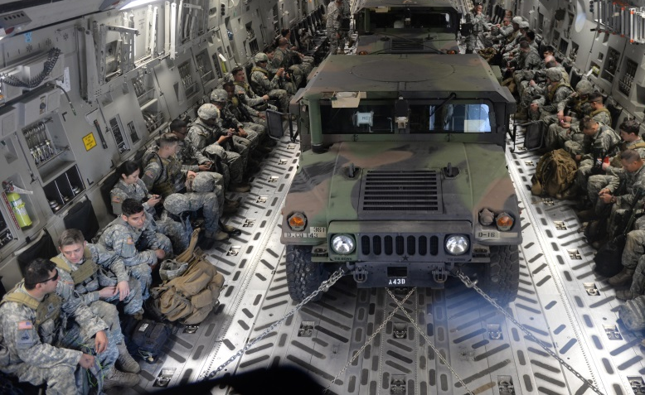
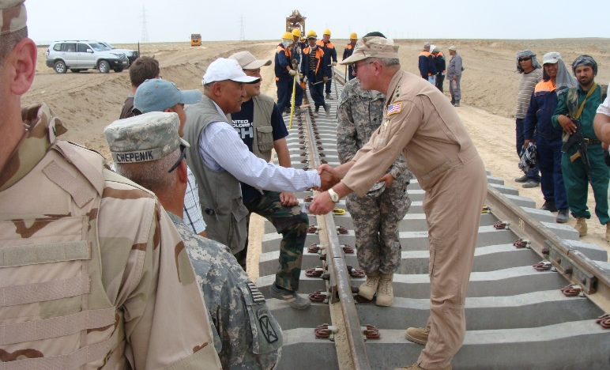
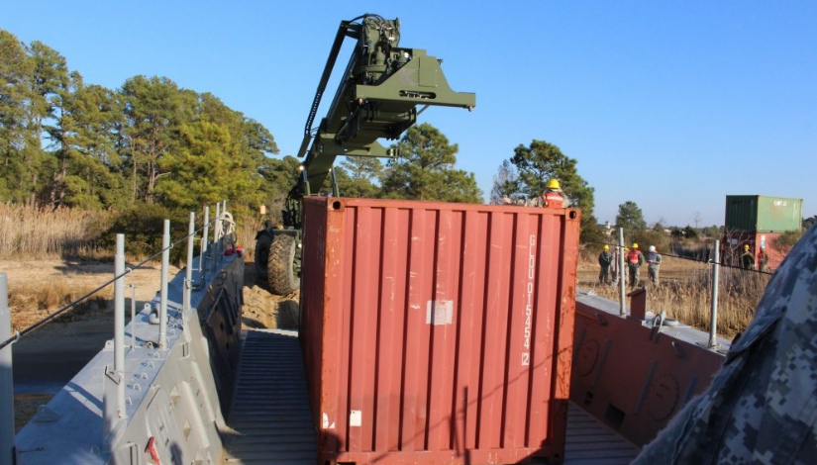
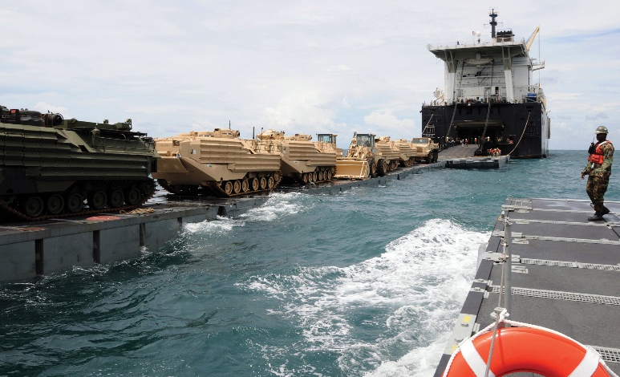
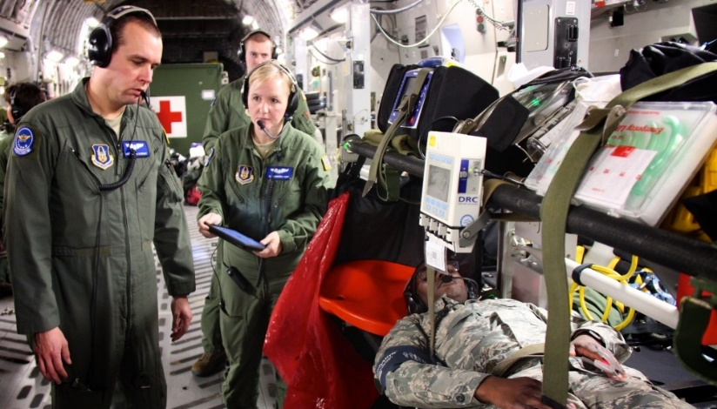
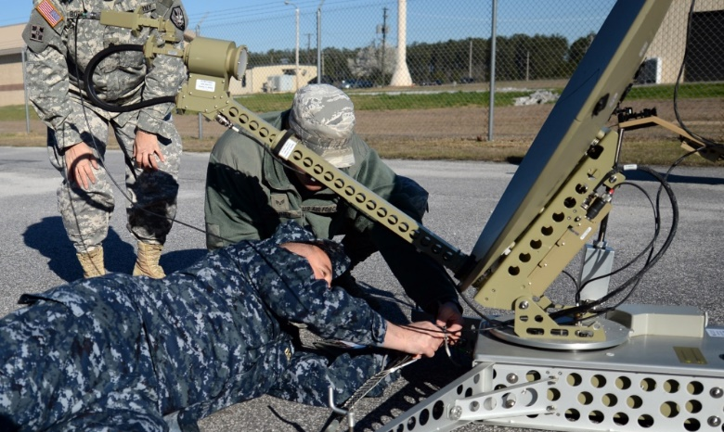
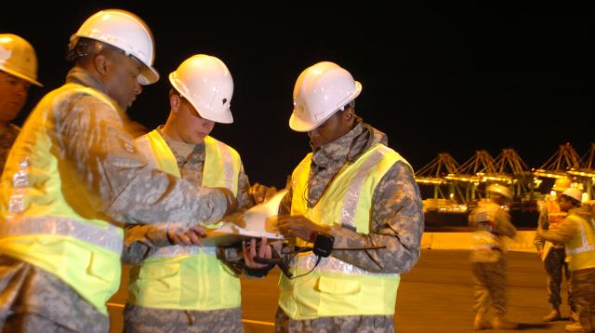
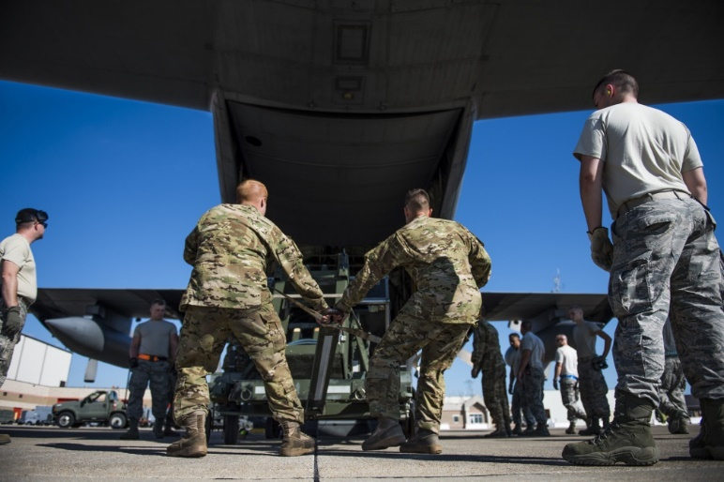
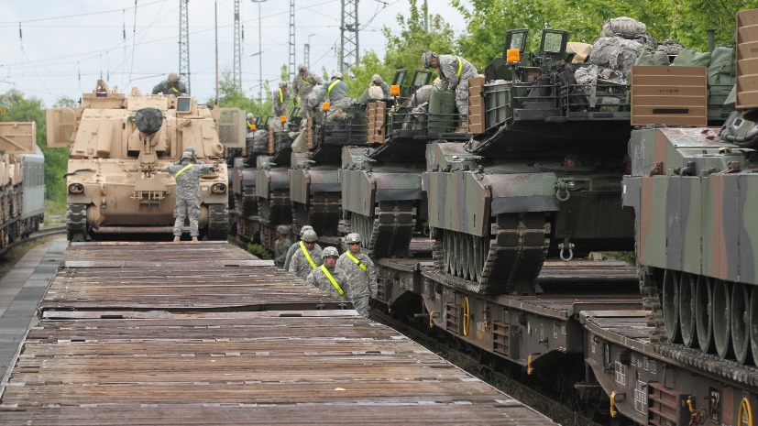
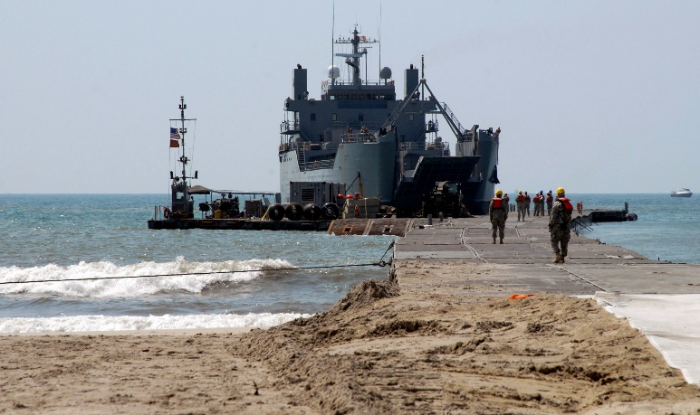
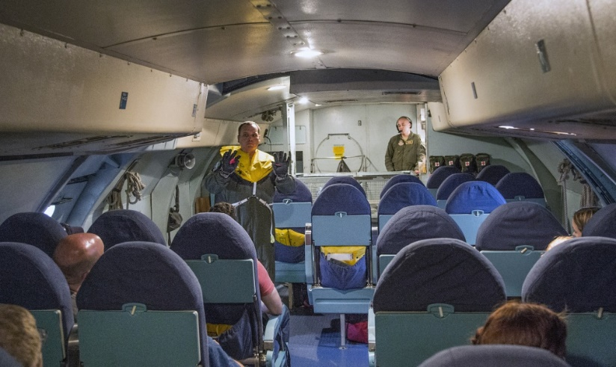
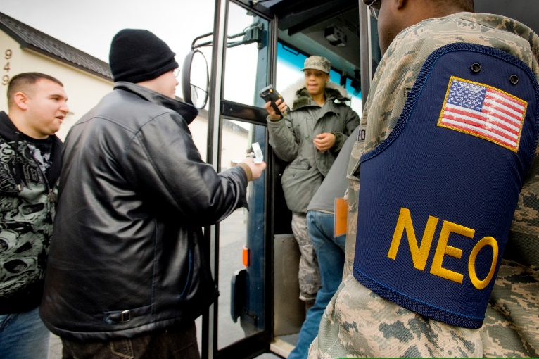
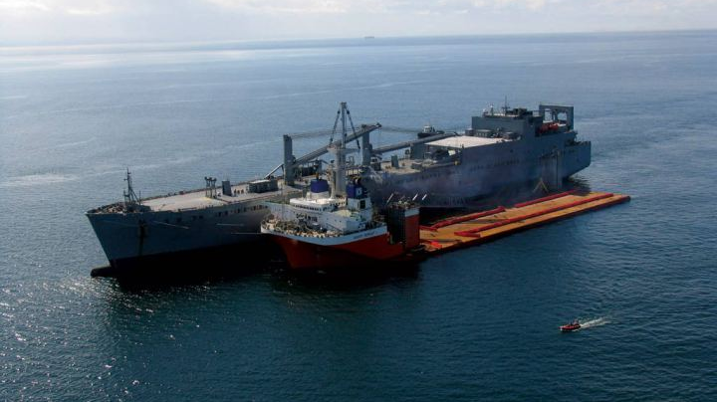
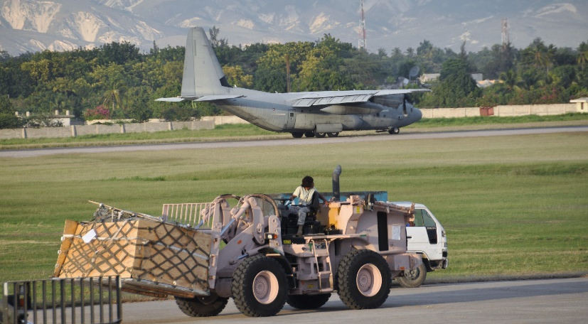
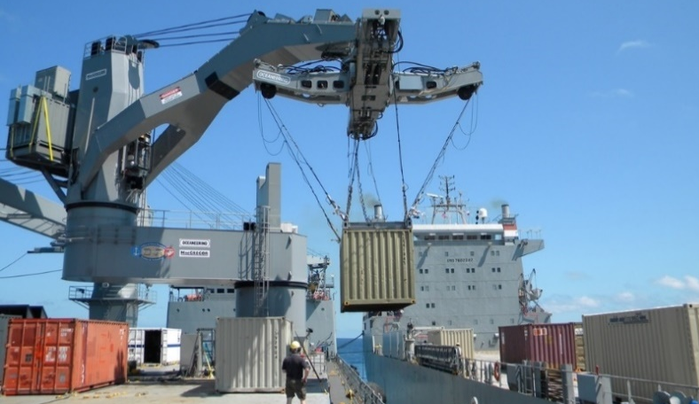
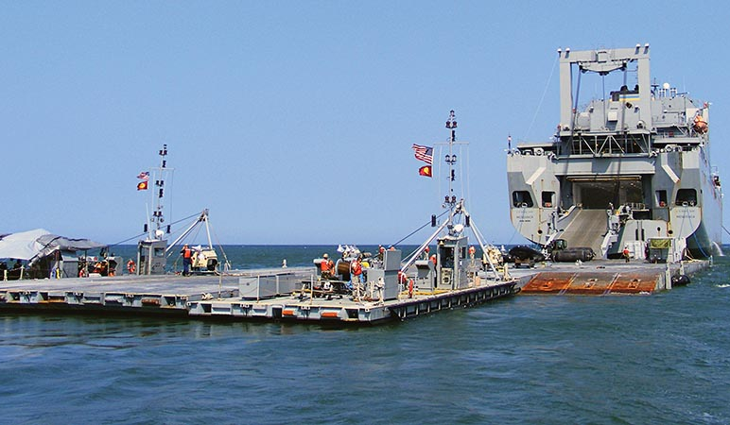
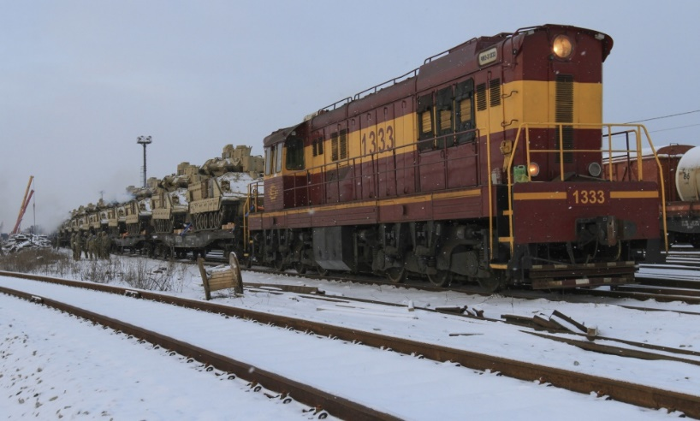
BOTTOM LINE
TOGETHER, WE DELIVER.
Get the Warfighter
to the Fight
Sustain the Warfighter During the Fight
Support Rapid Force Maneuver &
Patient Movement
Bring the
Warfighter Home
An Immediate Force Tonight…A Decisive Force When Needed

Slide 10
Together, we deliver.

Slide 11
IMPORTANT TERMS
TOGETHER, WE DELIVER.
Joint Logistics Environment (JLE)
The sum of conditions and circumstances that affect logistics which exists at the strategic, operational, and tactical levels
Joint Logistics Enterprise (JLEnt)
Multi-tiered matrix of key global logistics providers cooperatively engaged or structured to achieve a common purpose
DOD executes its JLEnt role through the JDDE
Defense Transportation System (DTS)
That portion of the worldwide transportation infrastructure that supports DOD transportation needs
Consists of 3 major sources of trans resources and capabilities: military, commercial, and host nation
Joint Deployment & Distribution Enterprise (JDDE)
Complex of equipment, procedures, doctrine, leaders, technical connectivity, information, shared knowledge, organizations, facilities, training, and materiel necessary to conduct joint distribution ops
DOD employs the JDDE to deliver joint end-to-end movement of forces and materiel, through the DTS, from point of origin to the designated point of need
JDDE is a critical part of the JLEnt and its governance is the JDDC’s primary responsibility

Slide 12
JOINT PUBLICATION BREAKOUT BY LEAD AGENT
TOGETHER, WE DELIVER.

